Slide 1
Deep Reinforcement Learning amidst Lifelong non-stationarity Arxiv
Kyeong Ryeol, Go
M.S. Candidate of OSI Lab

Slide 2
Contents
Levine, Sergey. "Reinforcement learning and control as probabilistic inference: Tutorial and review." arXiv preprint arXiv:1805.00909 (2018).
Haarnoja, Tuomas, et al. "Soft actor-critic: Off-policy maximum entropy deep reinforcement learning with a stochastic actor." International Conference on Machine Learning. PMLR, 2018.
Lee, Alex X., et al. "Stochastic latent actor-critic: Deep reinforcement learning with a latent variable model." arXiv preprint arXiv:1907.00953 (2019).
Xie, Annie, James Harrison, and Chelsea Finn. "Deep reinforcement learning amidst lifelong non-stationarity." arXiv preprint arXiv:2006.10701 (2020).

Slide 3
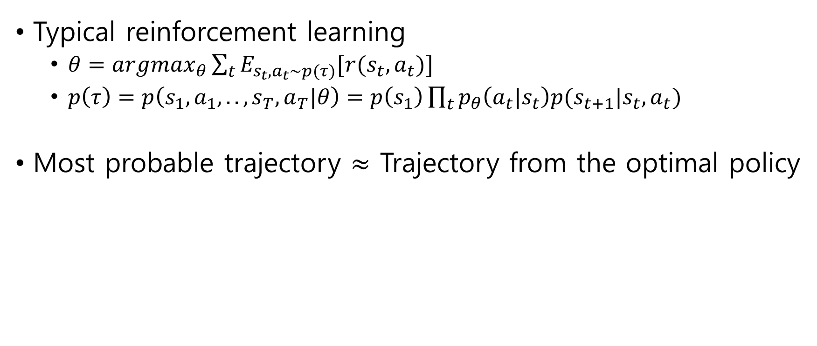
Reinforcement learning
Typical reinforcement learning
$θ=argmax_{θ}\sum_{t}{E_{s_{t},a_{t}\sim p(τ)}[r(s_{t},a_{t})]}$
$p\left(τ\right)=p\left(s_{1},a_{1},..,s_{T}, a_{T}|θ\right)=p\left(s_{1}\right)\prod_{t}{p_{θ}\left(a_{t}|s_{t}\right)p(s_{t+1}|s_{t},a_{t})}$
Most probable trajectory $≈$ Trajectory from the optimal policy

Slide 4
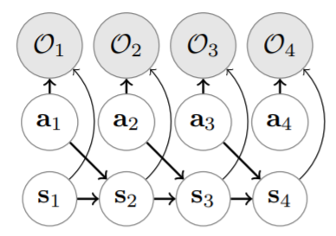
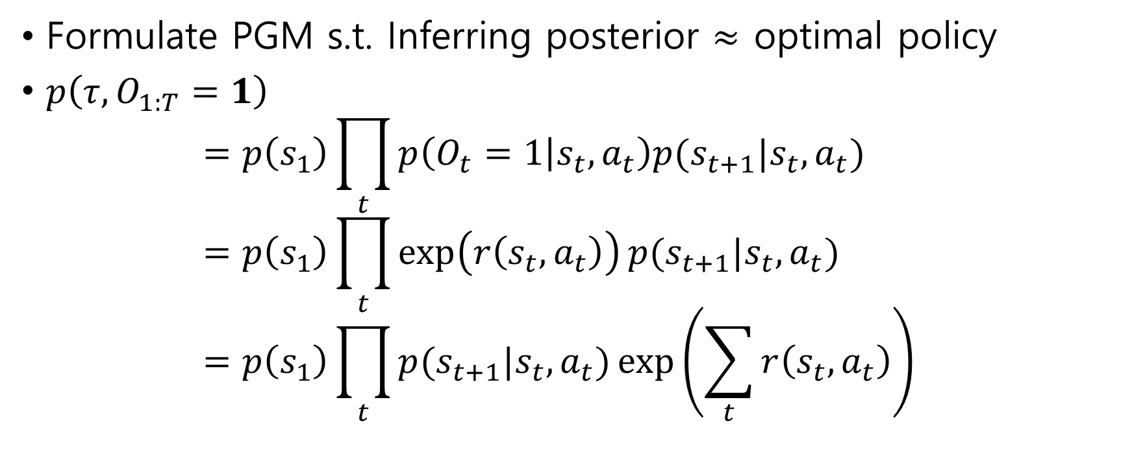
Optimality
Formulate PGM s.t. Inferring posterior $≈$ optimal policy
$p\left(τ,O_{1:T}=1\right)$ $=p\left(s_{1}\right)\prod_{t}{p\left(O_{t}=1 | s_{t},a_{t}\right)p(s_{t+1}|s_{t},a_{t})}$ $=p\left(s_{1}\right)\prod_{t}{\exp\left(r\left(s_{t},a_{t}\right)\right)p(s_{t+1}|s_{t},a_{t})}$ $=p\left(s_{1}\right)\prod_{t}{p(s_{t+1}|s_{t},a_{t})}\exp\left(\sum_{t}{r\left(s_{t},a_{t}\right)}\right)$

Slide 5
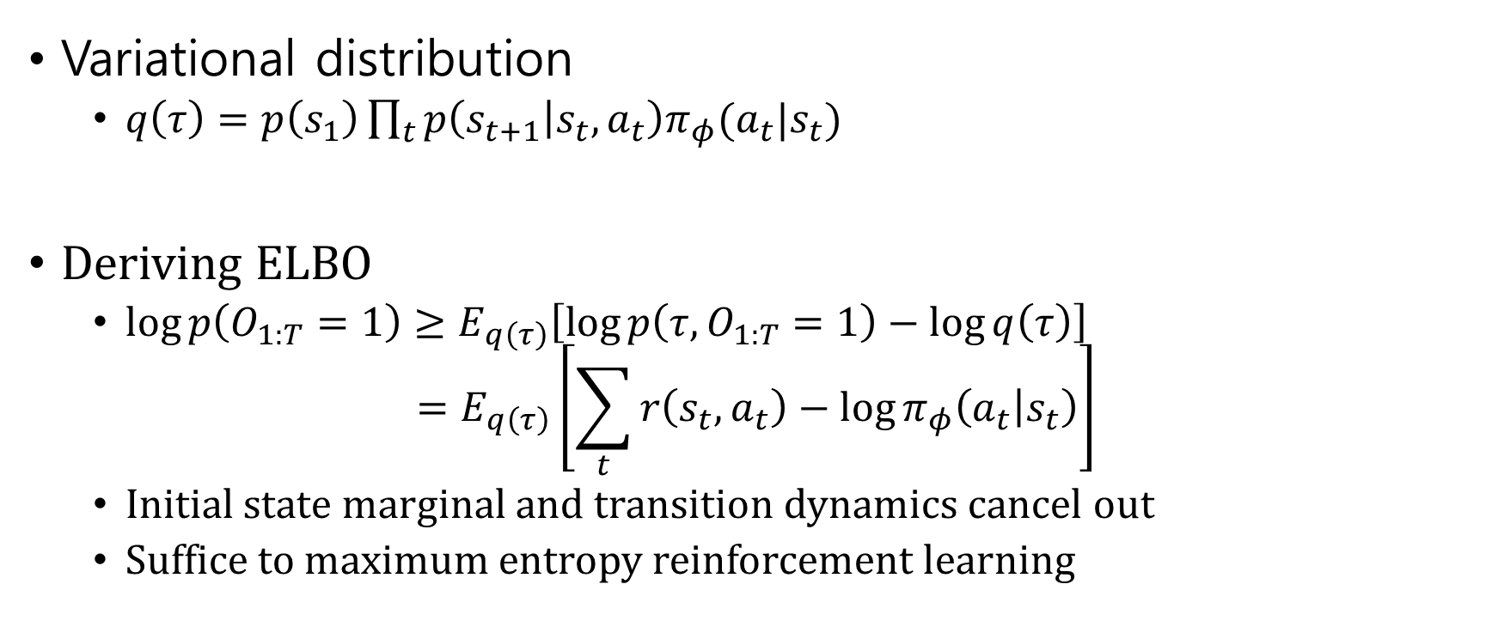
Approximate inference
Variational distribution
$q\left(τ\right)=p\left(s_{1}\right)\prod_{t}{p\left(s_{t+1} | s_{t},a_{t}\right)π_{φ}(a_{t}|s_{t})}$
Deriving ELBO
$\log{p\left(O_{1:T}=1\right)}≥E_{q\left(τ\right)}\left[\log{p\left(τ,O_{1:T}=1\right)−\log{q\left(τ\right)}}\right]$
$$=E_{q\left(τ\right)}\left[\sum_{t}{r\left(s_{t},a_{t}\right)−\log{π_{φ}\left(a_{t} | s_{t}\right)}}\right]$$
Initial state marginal and transition dynamics cancel out
Suffice to maximum entropy reinforcement learning

Slide 6
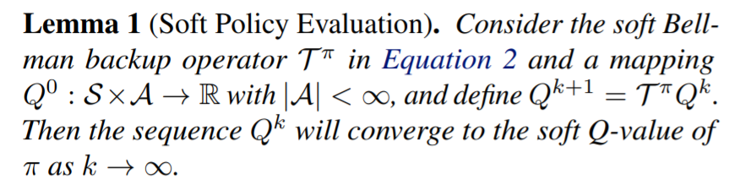
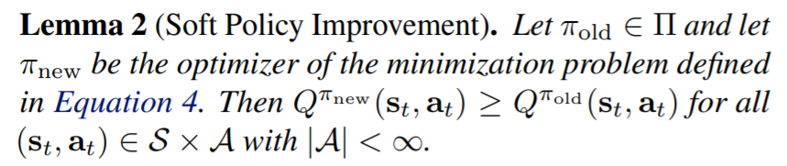
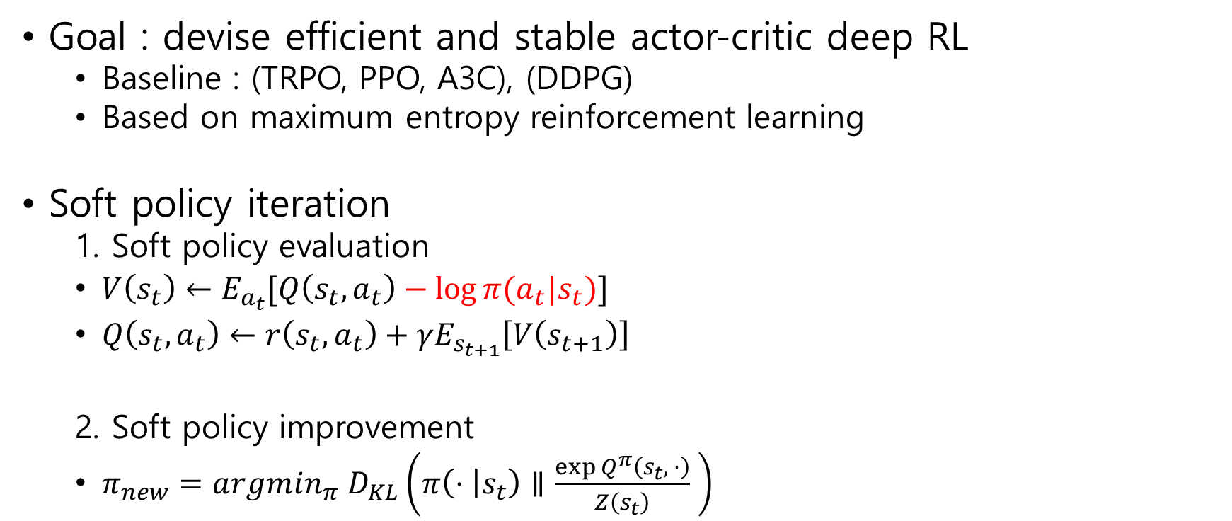
Soft Actor Critic (SAC)
Goal : devise efficient and stable actor-critic deep RL
Baseline : (TRPO, PPO, A3C), (DDPG)
Based on maximum entropy reinforcement learning
Soft policy iteration
1. Soft policy evaluation
$V\left(s_{t}\right)←E_{a_{t}}[Q\left(s_{t},a_{t}\right)−\log{π(a_{t}|s_{t})}]$
$Q\left(s_{t},a_{t}\right)←r\left(s_{t},a_{t}\right)+γE_{s_{t+1}}\left[V\left(s_{t+1}\right)\right]$
2. Soft policy improvement
$π_{new}=argmin_{π} D_{KL}\left(π\left(⋅ | s_{t}\right)∥\frac{\exp{Q^{π}\left(s_{t}, ⋅\right)}}{Z\left(s_{t}\right)} \right)$

Slide 7
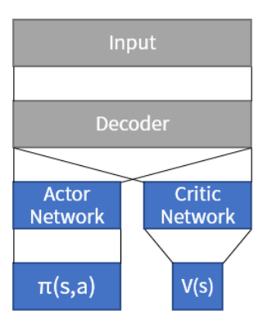
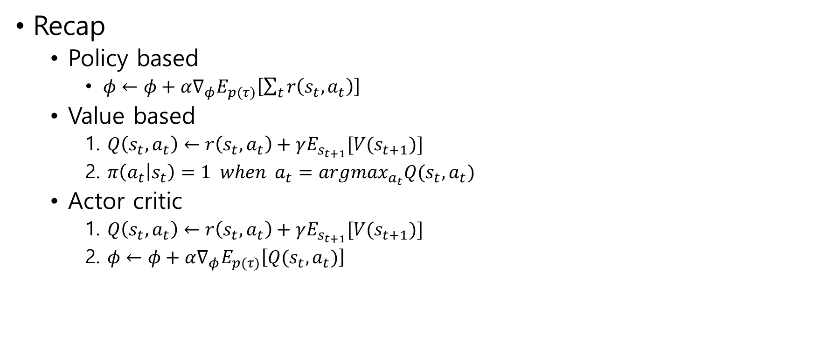
Soft Actor Critic (SAC)
Recap
Policy based
$φ←φ+α∇_{φ}E_{p(τ)}\left[\sum_{t}{r\left(s_{t}, a_{t}\right)}\right]$
Value based
1. $Q\left(s_{t},a_{t}\right)←r\left(s_{t},a_{t}\right)+γE_{s_{t+1}}[V(s_{t+1})]$
2. $π\left(a_{t} | s_{t}\right)=1 when a_{t}=argmax_{a_{t}}Q(s_{t},a_{t})$
Actor critic
1. $Q\left(s_{t},a_{t}\right)←r\left(s_{t},a_{t}\right)+γE_{s_{t+1}}[V(s_{t+1})]$
2. $φ←φ+α∇_{φ}E_{p(τ)}\left[Q(s_{t},a_{t})\right]$

Slide 8
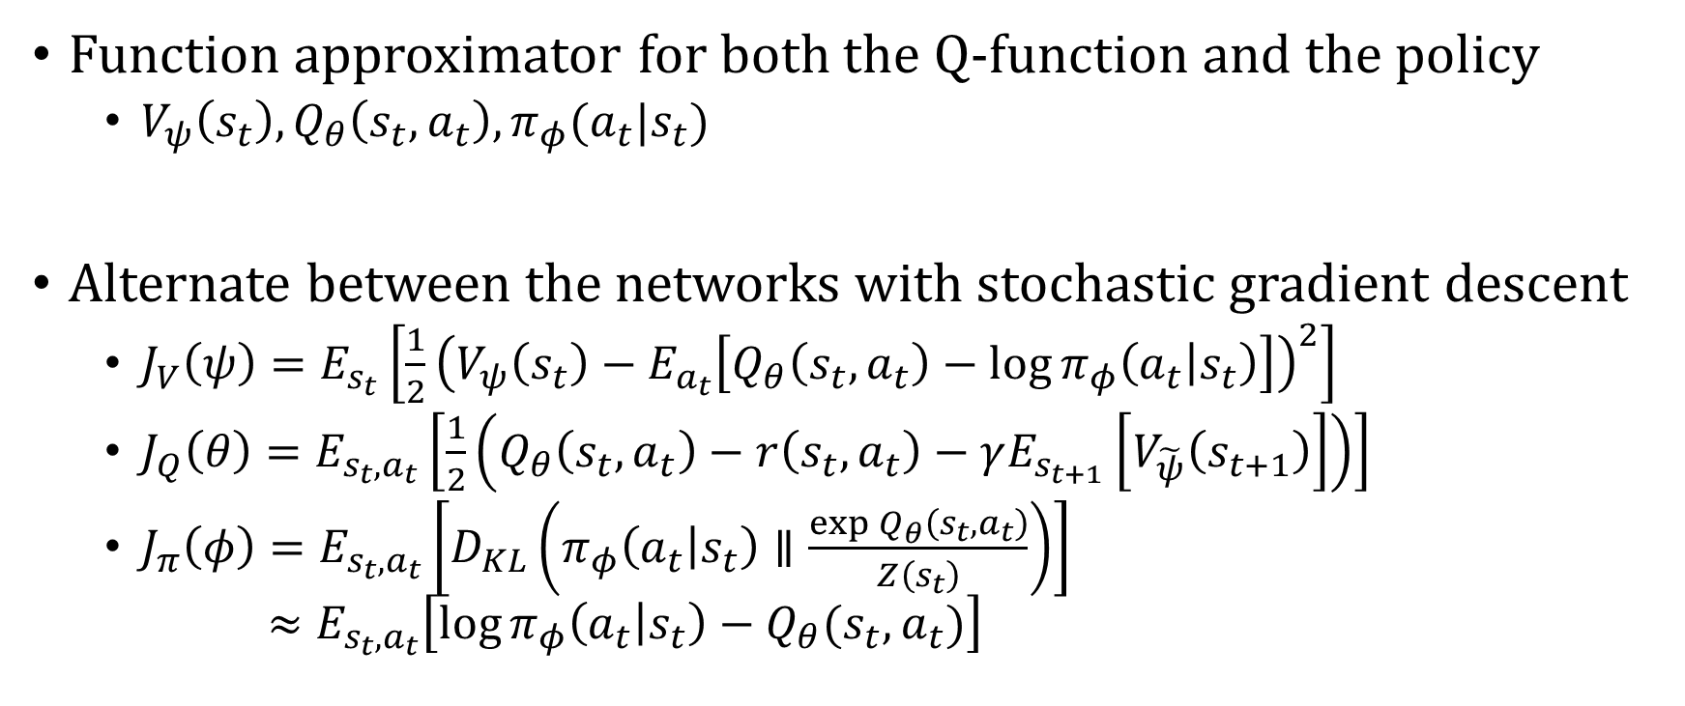
Overall training process
Function approximator for both the Q-function and the policy
$V_{ψ}\left(s_{t}\right), Q_{θ}\left(s_{t},a_{t}\right), π_{φ}(a_{t}|s_{t})$
Alternate between the networks with stochastic gradient descent
$J_{V}\left(ψ\right)=E_{s_{t}}\left[\frac{1}{2}{\left(V_{ψ}\left(s_{t}\right)−E_{a_{t}}\left[Q_{θ}\left(s_{t}, a_{t}\right)−\log{π_{φ}\left(a_{t} | s_{t}\right)}\right]\right)}^{2}\right]$
$J_{Q}\left(θ\right)=E_{s_{t},a_{t}}\left[\frac{1}{2}\left(Q_{θ}\left(s_{t},a_{t}\right)−r\left(s_{t},a_{t}\right)−γE_{s_{t+1}}\left[V_{\tilde{ψ}}\left(s_{t+1}\right)\right]\right)\right]$
$J_{π}\left(φ\right)=E_{s_{t},a_{t}}\left[D_{KL}\left(π_{φ}\left(a_{t} | s_{t}\right)∥\frac{\exp{Q_{θ}\left(s_{t},a_{t}\right)}}{Z\left(s_{t}\right)}\right)\right]$ $≈E_{s_{t},a_{t}}\left[\log{π_{φ}\left(a_{t} | s_{t}\right)}−Q_{θ}(s_{t},a_{t})\right]$

Slide 9
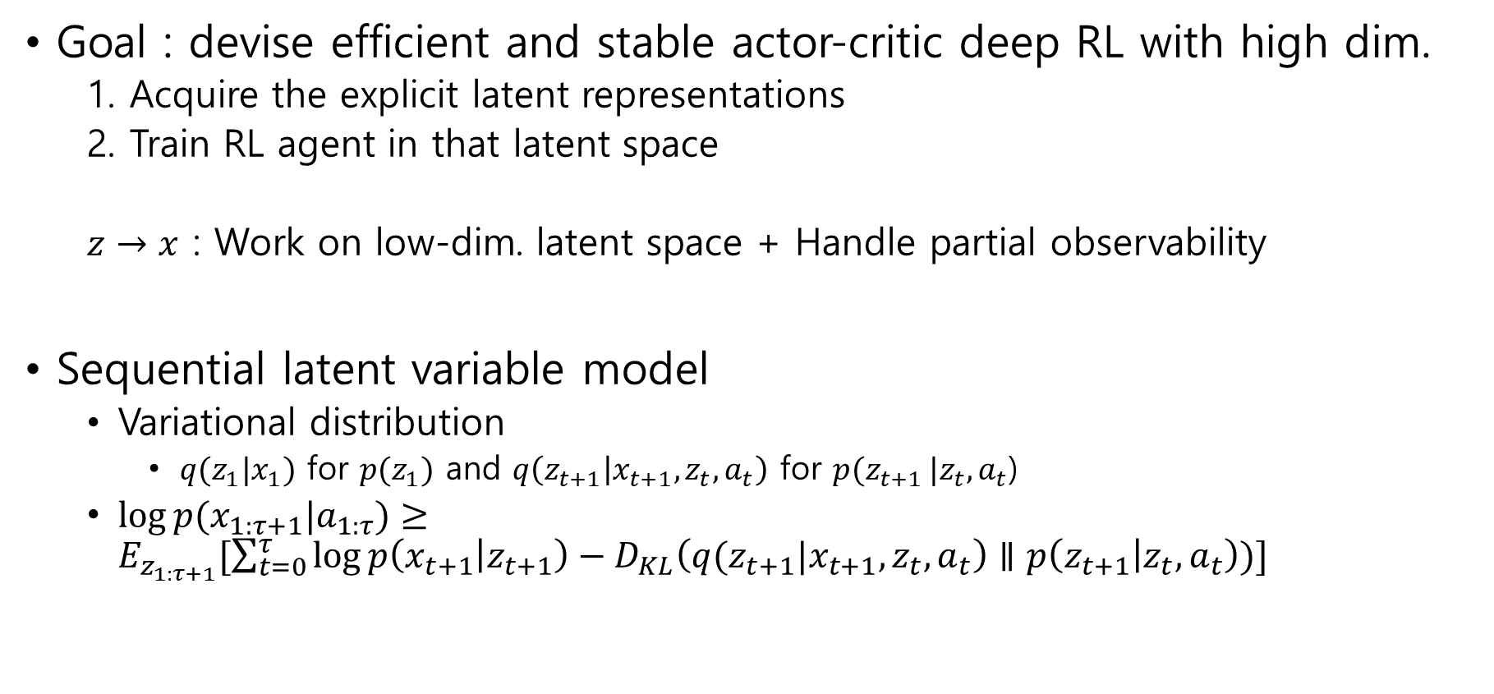
Soft Latent Actor Critic (SLAC)
Goal : devise efficient and stable actor-critic deep RL with high dim.
1. Acquire the explicit latent representations
2. Train RL agent in that latent space
$z→x$ : Work on low-dim. latent space + Handle partial observability
Sequential latent variable model
Variational distribution
$q(z_{1}|x_{1})$ for $p(z_{1})$ and $q\left(z_{t+1} | x_{t+1},z_{t},a_{t}\right)$ for $p(z_{t+1 }|z_{t},a_{t}$)
$\log{p(x_{1:τ+1}|a_{1:τ})}≥E_{z_{1:τ+1}}[\sum_{t=0}^{τ}{\log{p\left(x_{t+1} | z_{t+1}\right)}−D_{KL}\left(q(z_{t+1}|x_{t+1},z_{t},a_{t}\right)∥p\left(z_{t+1} | z_{t}, a_{t}\right))}]$

Slide 10
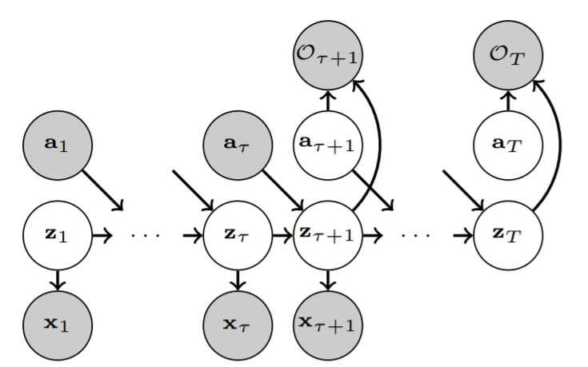
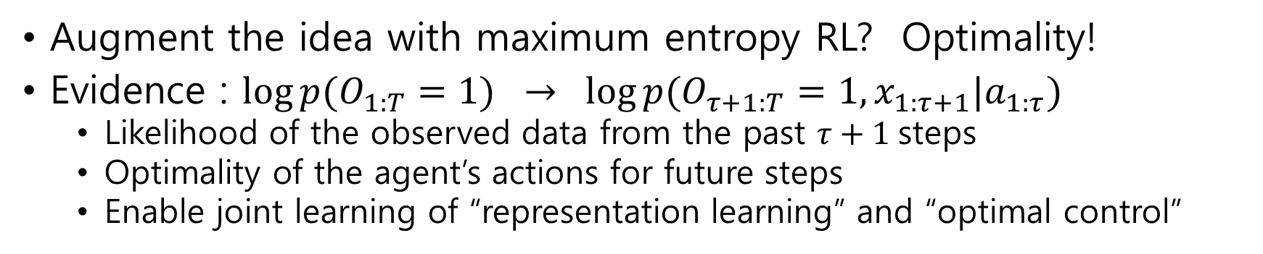
Soft Latent Actor Critic (SLAC)
Augment the idea with maximum entropy RL? Optimality!
Evidence : $\log{p(O_{1:T}=1)} → \log{p(O_{τ+1:T}=1,x_{1:τ+1}|a_{1:τ})}$
Likelihood of the observed data from the past $τ+1$steps
Optimality of the agent’s actions for future steps
Enable joint learning of “representation learning” and “optimal control”

Slide 11
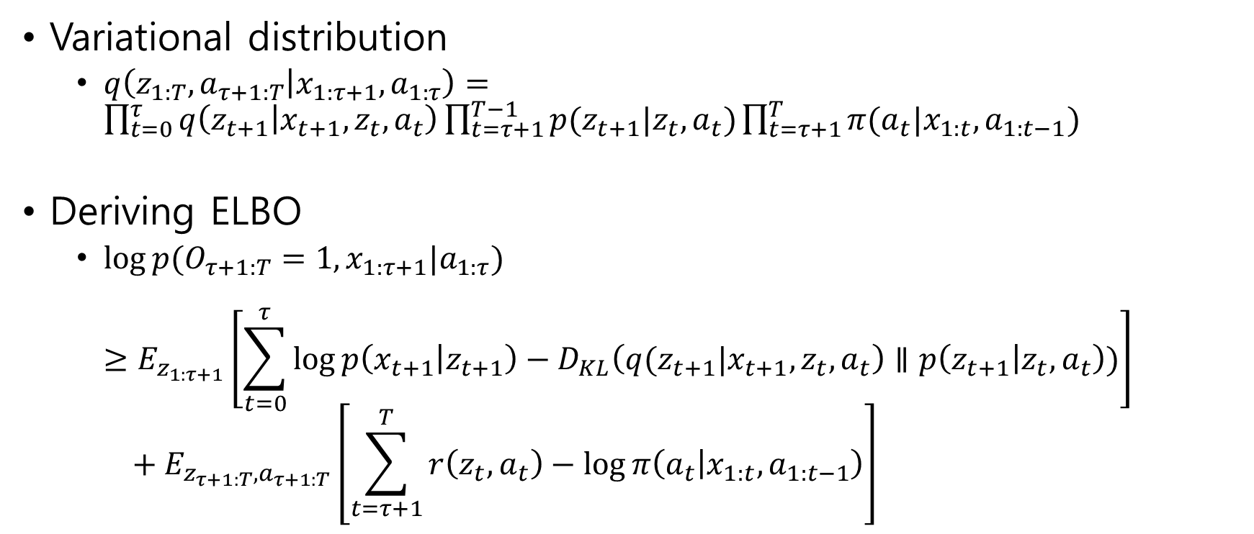
Soft Latent Actor Critic (SLAC)
Variational distribution
$q\left(z_{1:T}, a_{τ+1:T} | x_{1:τ+1},a_{1:τ}\right)=\prod_{t=0}^{τ}{q\left(z_{t+1} | x_{t+1},z_{t}, a_{t}\right)}\prod_{t=τ+1}^{T−1}{p(z_{t+1}|z_{t},a_{t})}\prod_{t=τ+1}^{T}{π(a_{t}|x_{1:t},a_{1:t−1})}$
Deriving ELBO
$\log{p(O_{τ+1:T}=1, x_{1:τ+1}|a_{1:τ})}$ $≥E_{z_{1:τ+1}}\left[\sum_{t=0}^{τ}{\log{p\left(x_{t+1} | z_{t+1}\right)}−D_{KL}\left(q(z_{t+1}|x_{t+1},z_{t},a_{t}\right)∥p\left(z_{t+1} | z_{t}, a_{t}\right))}\right]$ $+ E_{z_{τ+1:T}, a_{τ+1:T}}\left[\sum_{t=τ+1}^{T}{r\left(z_{t},a_{t}\right)−\log{π\left(a_{t} | x_{1:t},a_{1:t−1}\right)}}\right]$

Slide 12
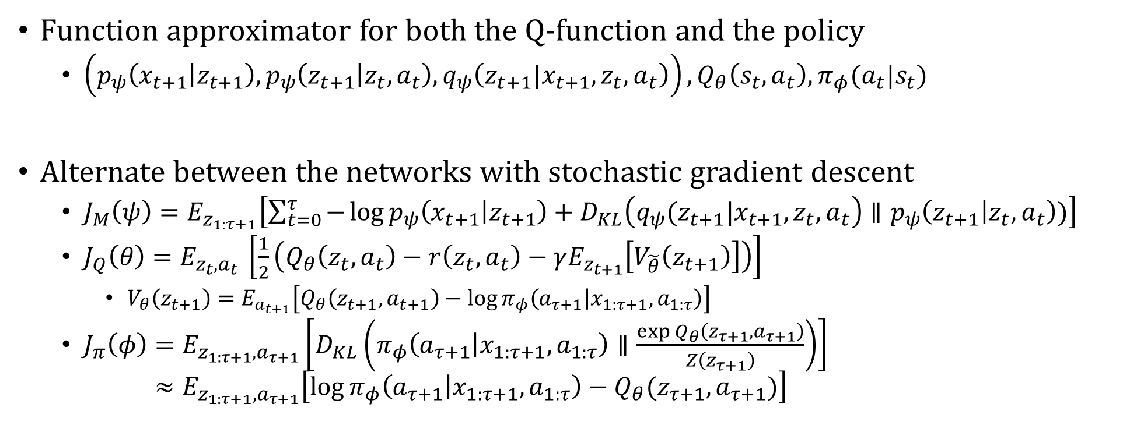
Overall training process
Function approximator for both the Q-function and the policy
$\left(p_{ψ}\left(x_{t+1} | z_{t+1}\right), p_{ψ}\left(z_{t+1} | z_{t},a_{t}\right), q_{ψ}\left(z_{t+1}|x_{t+1},z_{t}, a_{t}\right)\right), Q_{θ}\left(s_{t},a_{t}\right), π_{φ}(a_{t}|s_{t})$
Alternate between the networks with stochastic gradient descent
$J_{M}\left(ψ\right)=E_{z_{1:τ+1}}\left[\sum_{t=0}^{τ}{−\log{p_{ψ}\left(x_{t+1} | z_{t+1}\right)}+D_{KL}\left(q_{ψ}(z_{t+1}|x_{t+1},z_{t},a_{t}\right)∥p_{ψ}\left(z_{t+1} | z_{t}, a_{t}\right))}\right]$
$J_{Q}\left(θ\right)=E_{z_{t},a_{t} }\left[\frac{1}{2}\left(Q_{θ}\left(z_{t},a_{t}\right)−r\left(z_{t},a_{t}\right)−γE_{z_{t+1}}\left[V_{\tilde{θ}}\left(z_{t+1}\right)\right]\right)\right]$
$V_{θ}\left(z_{t+1}\right)=E_{a_{t+1}}\left[Q_{θ}\left(z_{t+1},a_{t+1}\right)−\log{π_{φ}\left(a_{τ+1} | x_{1:τ+1},a_{1:τ}\right)}\right]$
$J_{π}\left(φ\right)=E_{z_{1:τ+1},a_{τ+1}}\left[D_{KL}\left(π_{φ}\left(a_{τ+1} | x_{1:τ+1},a_{1:τ}\right)∥\frac{\exp{Q_{θ}\left(z_{τ+1},a_{τ+1}\right)}}{Z\left(z_{τ+1}\right)}\right)\right]$ $≈E_{z_{1:τ+1},a_{τ+1}}\left[\log{π_{φ}\left(a_{τ+1} | x_{1:τ+1},a_{1:τ}\right)}−Q_{θ}(z_{τ+1},a_{τ+1})\right]$

